Slide 1


PROJECT 2
Cody, Dylan, Casey, Sandy, Abdul & Shantesh
Notes:
Cody will do the intro slide and table of contents

Slide 2

TABLE OF CONTENTS
01
EXECUTIVE SUMMARY
02
DATA COLLECTION
03
CLEANUP
04
EXPLORATION PROCESSES
05
THE APPROACH
06
FUTURE DEVELOPMENT
07
RESULTS
08
CONCLUSION
09
THANK YOU!

Slide 3
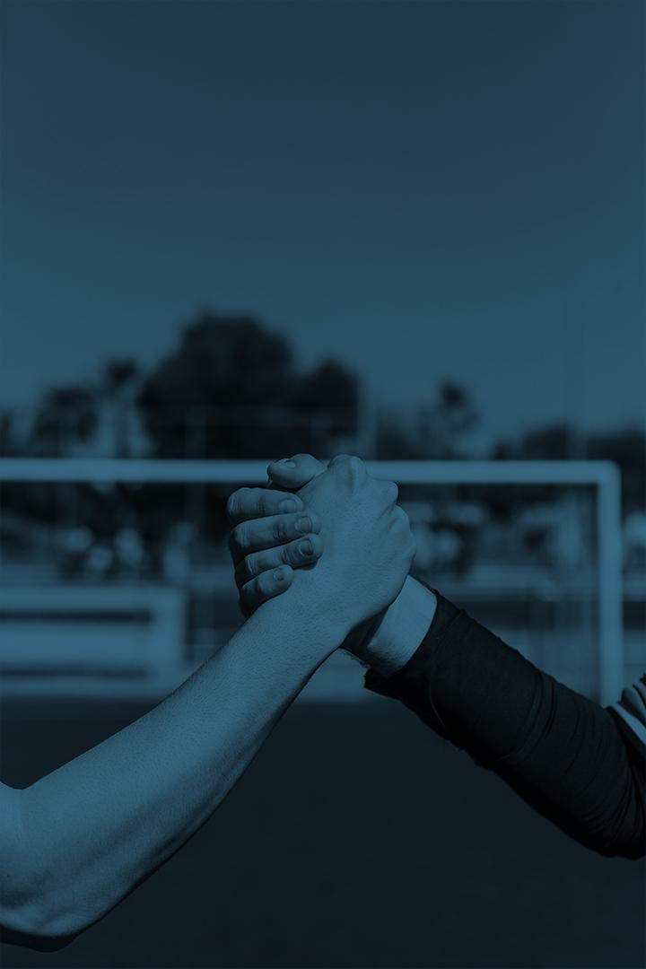
EXECUTIVE SUMMARY
This project leverages machine learning algorithms and data analysis techniques to predict EPL match results (wins, losses, and draws) based on historical match data, team stats, and other factors. This code is intended for sports analysts, EPL fans seeking to gain insights into match outcomes and team performance, and other data scientists exploring the application of machine learning in sports analytics and predictive modeling.
Notes:
Dylan to cover this slide, basically read off the slide and add any personal context to it about your love of soccer and interest in game predictions.

Slide 4
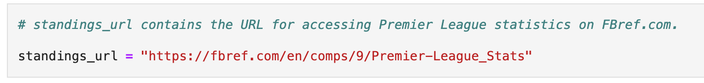

DATA COLLECTION
URL
IMPORTING DATA
Notes:
Talking points – Dylan – discuss what the website contains and the overall idea of using beautiful soup to web scrape that webpage for certain tables and data extraction that was then saved as a csv for importing into the model

Slide 5
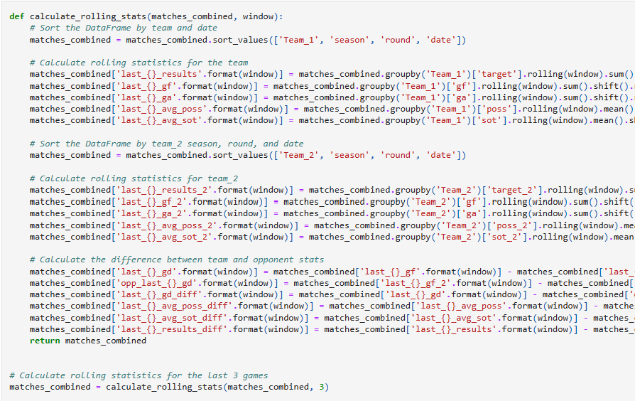
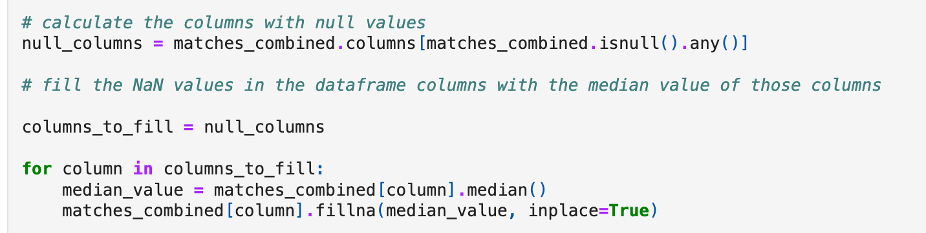
DATA CLEANUP & ENGINEERING
Notes:
Casey – talking points –data and feature engineering by using median values to fill in NA values

Slide 6
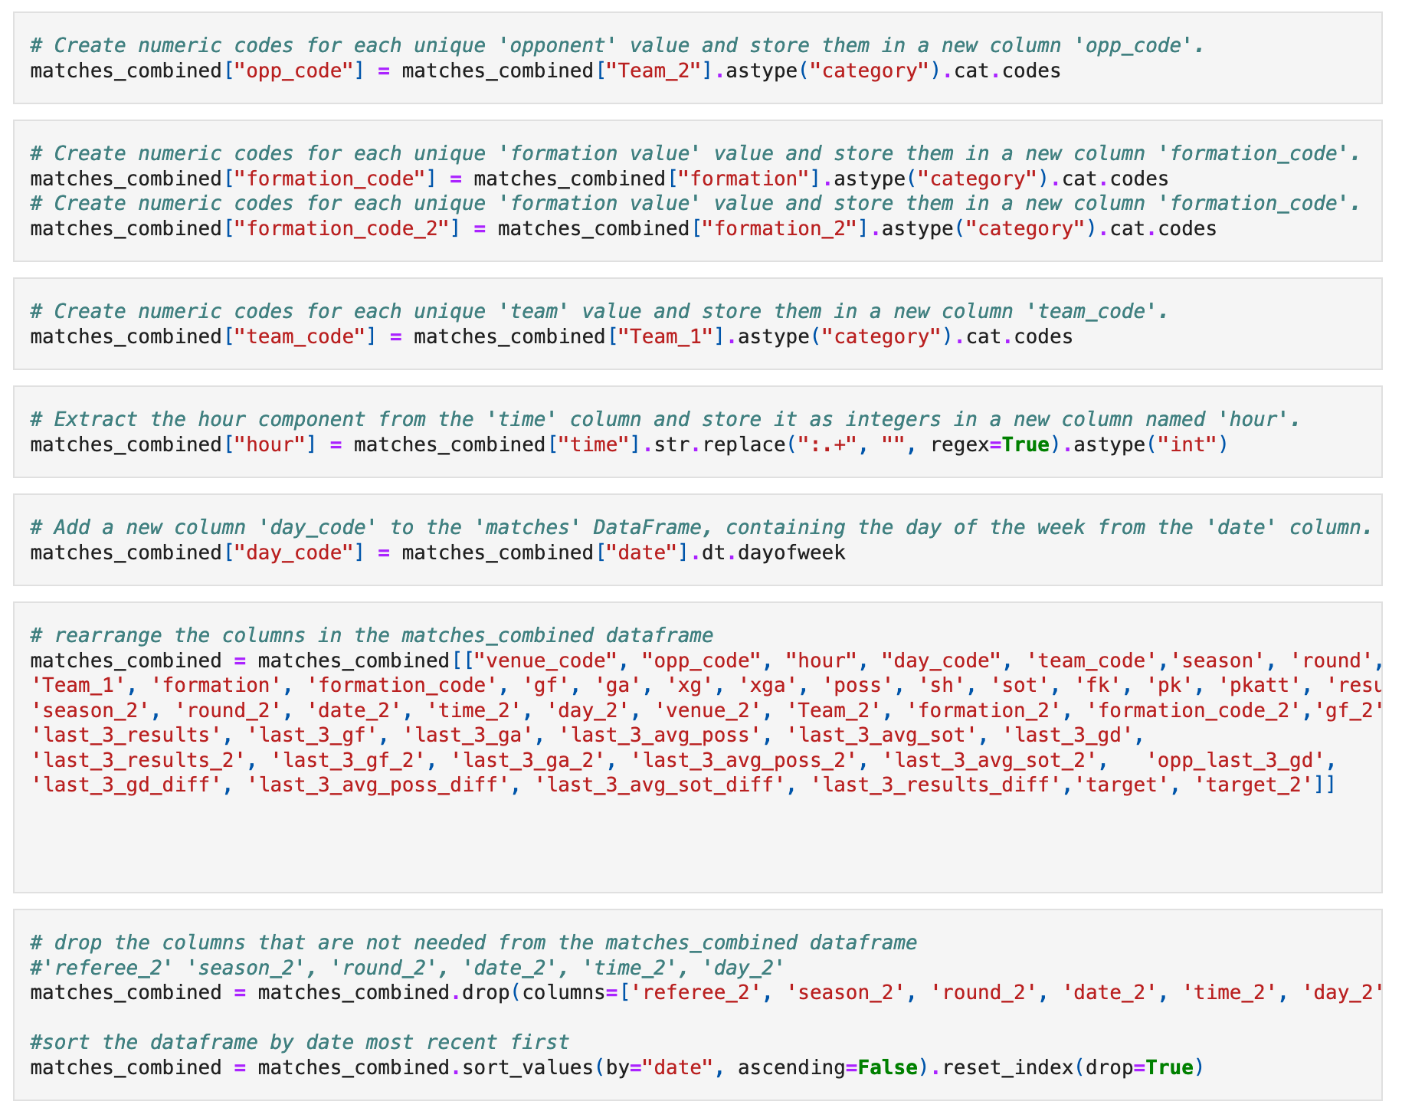
EXPLORATION PROCESSES
Notes:
Casey – continued talking points – describe the use of categorical encoding to get string values to integers for better model performance, also utilized data cleaning by re-arranging the columns for readability and value extraction to eliminate clutter and unused data features

Slide 7
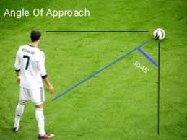
THE APPROACH
GitHub organization: Each member has their own branch for coding.
Limit of two programmers changing code simultaneously.
Main branch merges require group consensus.
Notes:
Cody to talk through this one

Slide 8
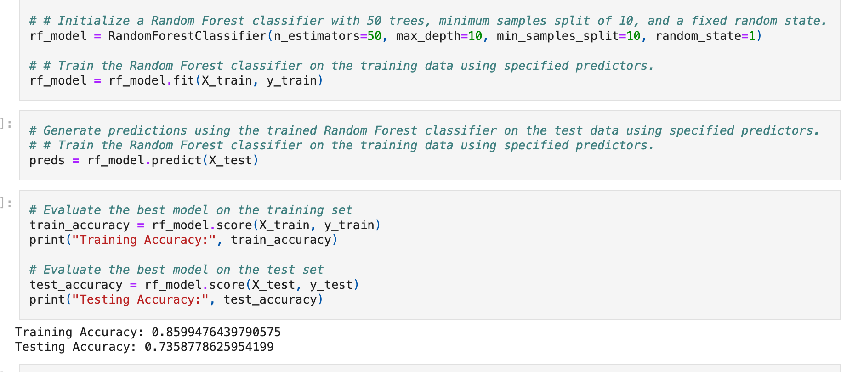
RESULTS
Notes:
Dylan – general conversation about the use of random forest and how we used a variety of different hyperparameters as well as modifying which features we used to get to a better accuracy. Seeing that this model seemed to be overfit, we transitioned to a gradient boosted model that yielded better results, next slide

Slide 9
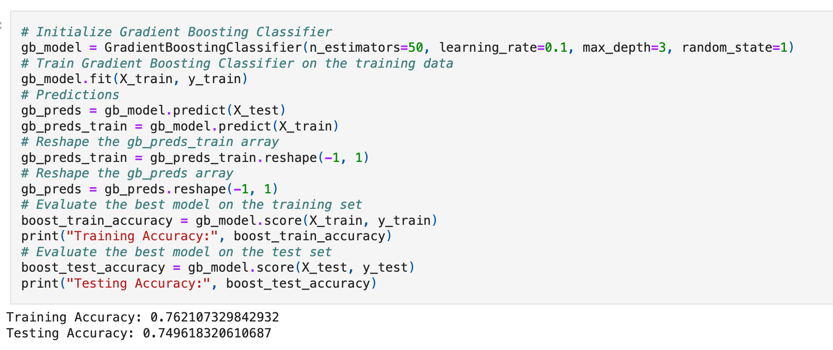
CONCLUSION
Notes:
Dylan – our conclusion was that the gradient boosting model yielded better results right out of the box so we focused on iterating through changing the hyper parameters and the features used to train the model that yielded in the above accuracies that were the highest with the least amount of overfitting, thus we stuck with this model for our conclusion. While these accuracies are good in a model, they still show that trying to predict the outcome of a soccer match are very hard and have a large variety of factors to consider before truly trusting the outputs of the model. Things that can vary the outcomes greatly are things like player injuries, suspensions, weather, referee selection and many other factors.

Slide 10
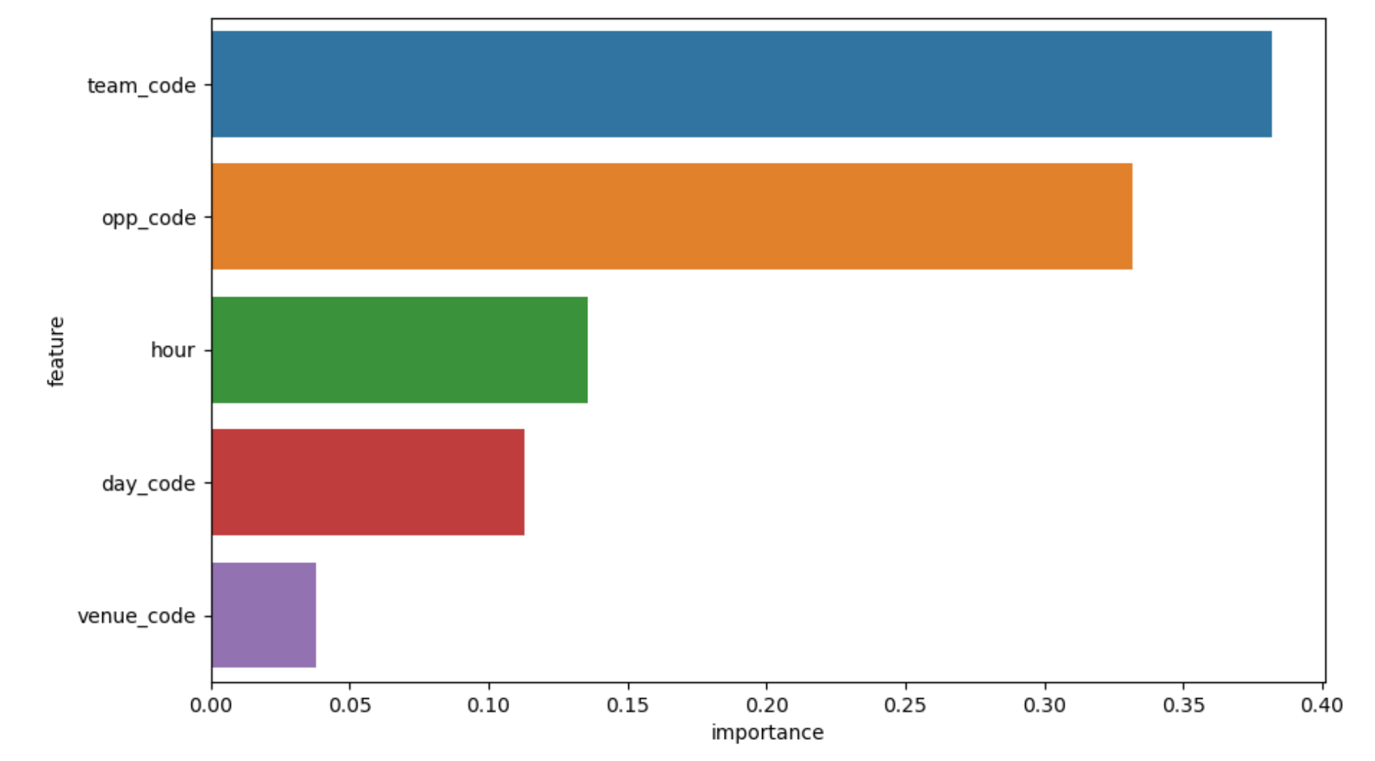
FUTURE DEVELOPMENT
Notes:
Casey – discuss how we utilized the feature importance functions of each model to determine which features were driving the most influence to the models, this allowed us to narrow down our efforts on feature engineering and continue our focus on model improvement. Using these features, we began working on an interactive aspect to this project that would allow for the user to choose the values of these features to get a prediction based on their custom inputs. We ran out of time in trying to implement this, but we would have explored this further along with other models as well to get the best results possible given the dataset we had at our disposal.

Slide 11
2
Notes:
Cody – ultimately, we feel as a group that the biggest goal we scored was learning more about machine learning and the different impacts that datasets, features and modeling types can have on predicting and analyzing data. As many of us are navigating full time jobs and lots of travel among our group, I want to thank all members of the team for stepping up when others weren’t available to aid in yet another successful project experience.

Slide 12

THANK YOU!
GROUP 2

